Slide 1


How to Restore Relationships
Matthew 18:15-20
Dr. Rick Griffith
Singapore Bible College
BibleStudyDownloads.org
10 December 2006
6 March 2011

Slide 2
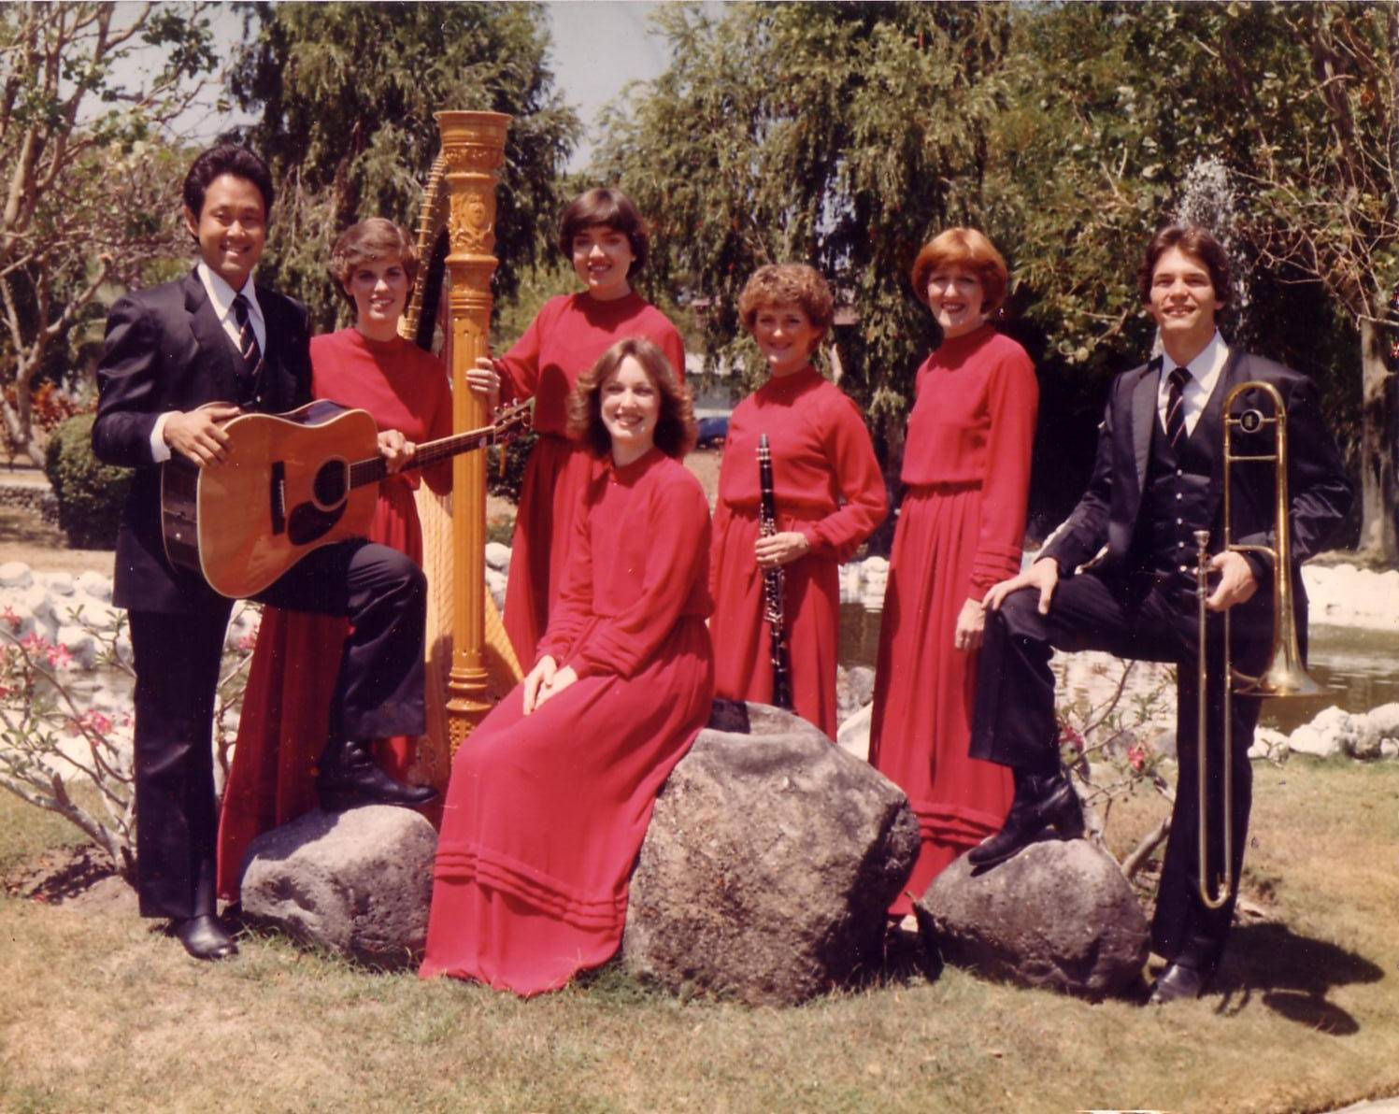
The Crossroads (1981-83)
Notes:
Some 35 years ago I sang on a music team of seven musicians called Crossroads. If you can’t tell, I am the guy who is not Japanese.

Slide 3
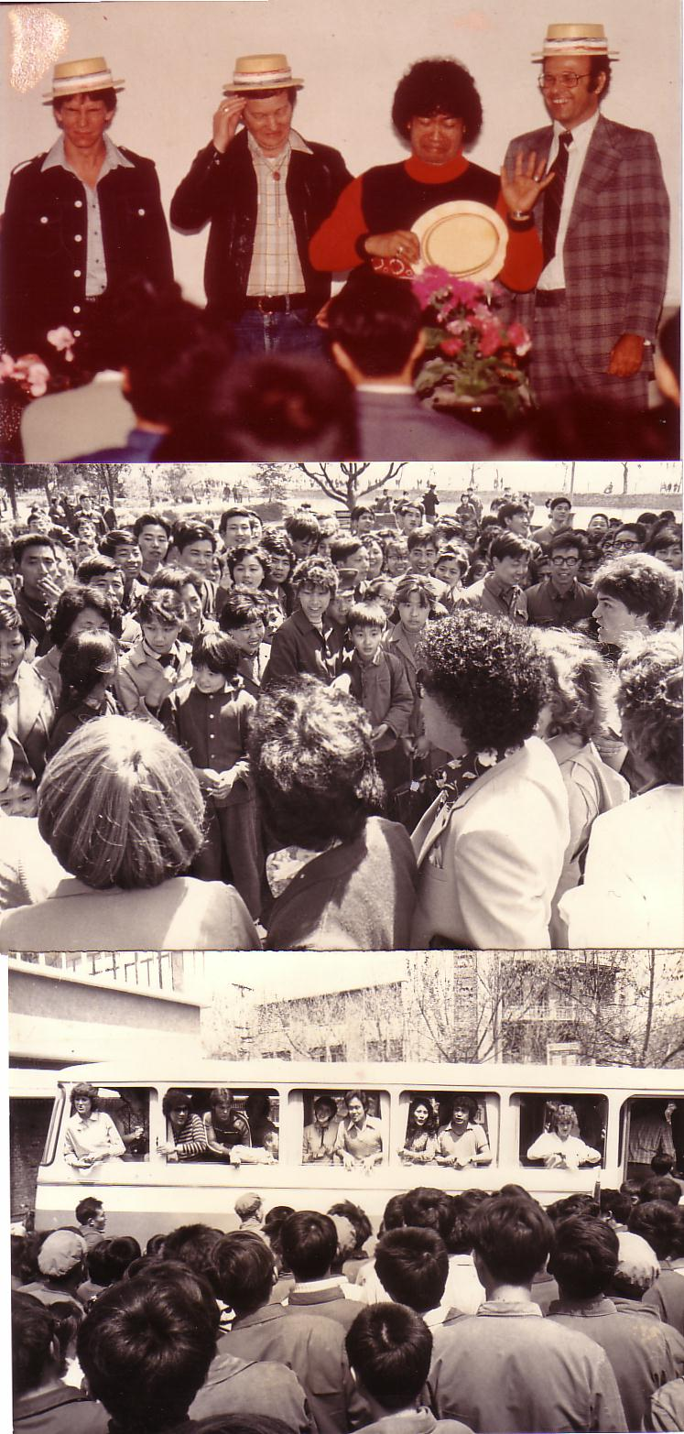
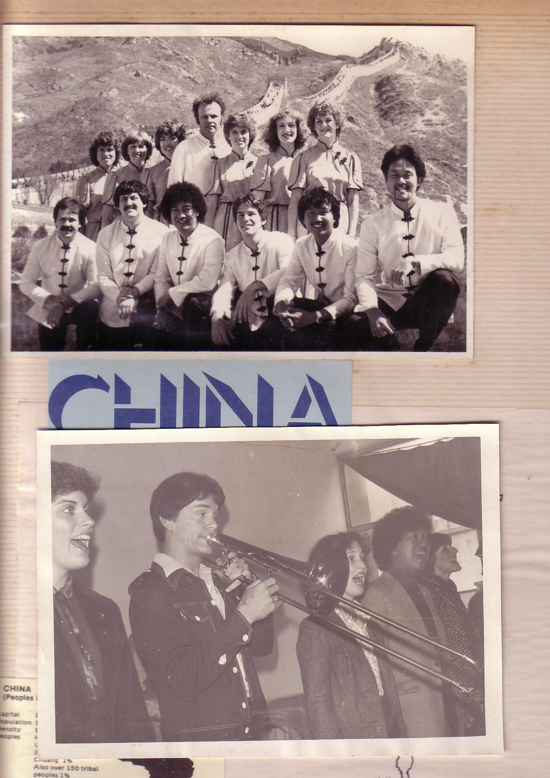
China, 1981
Notes:
We shared the gospel in China and—praise God—we reached over 600 people per concert!

Slide 4
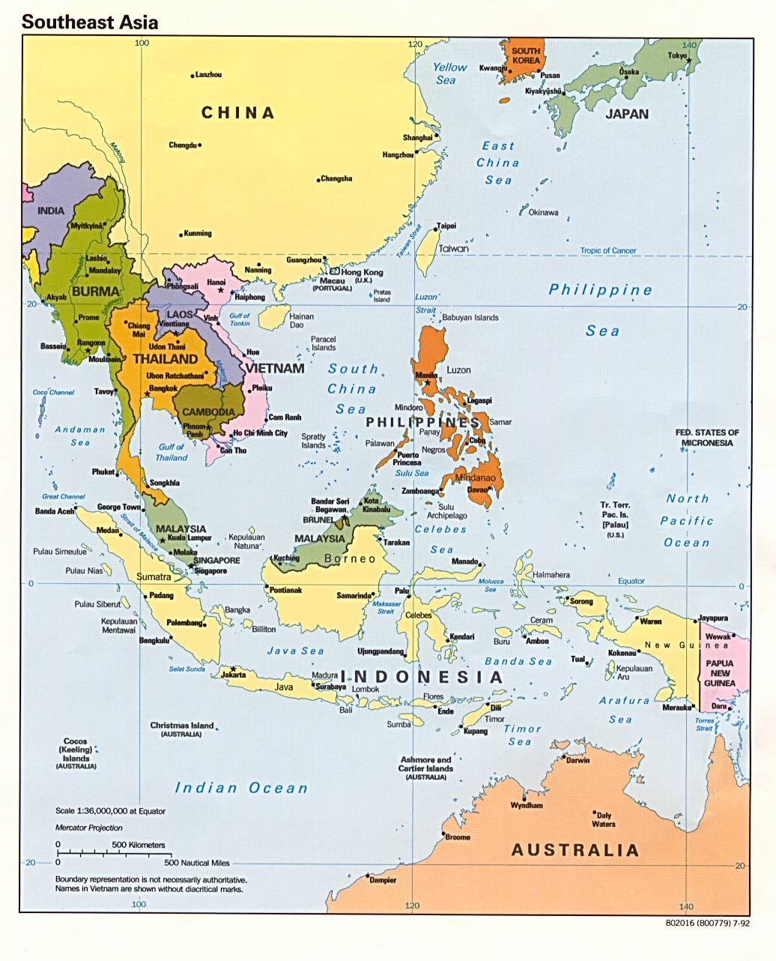
Crossroads Ministry
Korea
China
Japan
Hong Kong
Taiwan
Macau
Thailand
Philippines
Malaysia
Singapore
Indonesia
Notes:
The Crossroads team shared the gospel in 11 Asian nations and saw over 10,000 people trust Christ as indicated in comment cards at our 269 concerts.

Slide 5
Black
Notes:
If you know anything about spiritual warfare, it is that the enemy of our souls concentrates his efforts on believers who are having an impact for Christ.
In our team, the opposition came from within—relationships that were a challenge. On that team was one particular woman named Kay. She was a godly woman but we didn’t see eye-to-eye at all. In fact, many times she felt that I just a "mister-know-it-all.” She didn’t like my mannerisms, my clothes, or my insights in our group Bible studies. She avoided being around me and it seemed that I could do nothing right! She saw me as really arrogant.
So what do you do when you are forced into a working relationship with someone who just plain does not like you? I found that I couldn’t really avoid Kay. After all, every day we had four hours of music practice with the team. I had to sing in harmony with her—literally! But discord often reigned. Then we had a concert to give and had to work together.

Slide 6

Relational Pillars
Relational Pillars
for believers
Notes:
God ministered to me then through two texts in Matthew that became "relational pillars" that I want to share with you today. These texts literally changed my life.

Slide 7
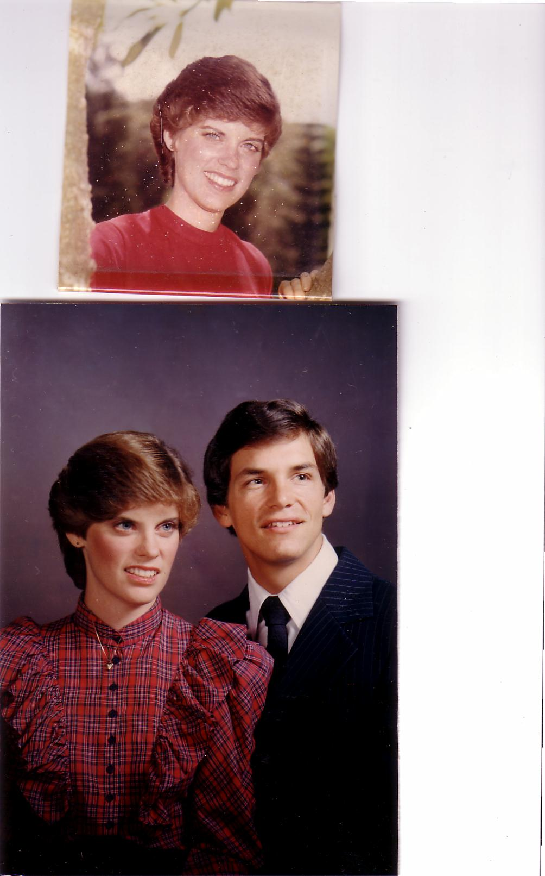
Romance, 1982
Notes:
They enabled Kay and me to reconcile our differences—so much so that three years after our initial differences Kay actually said "yes" to marrying me!

Slide 8
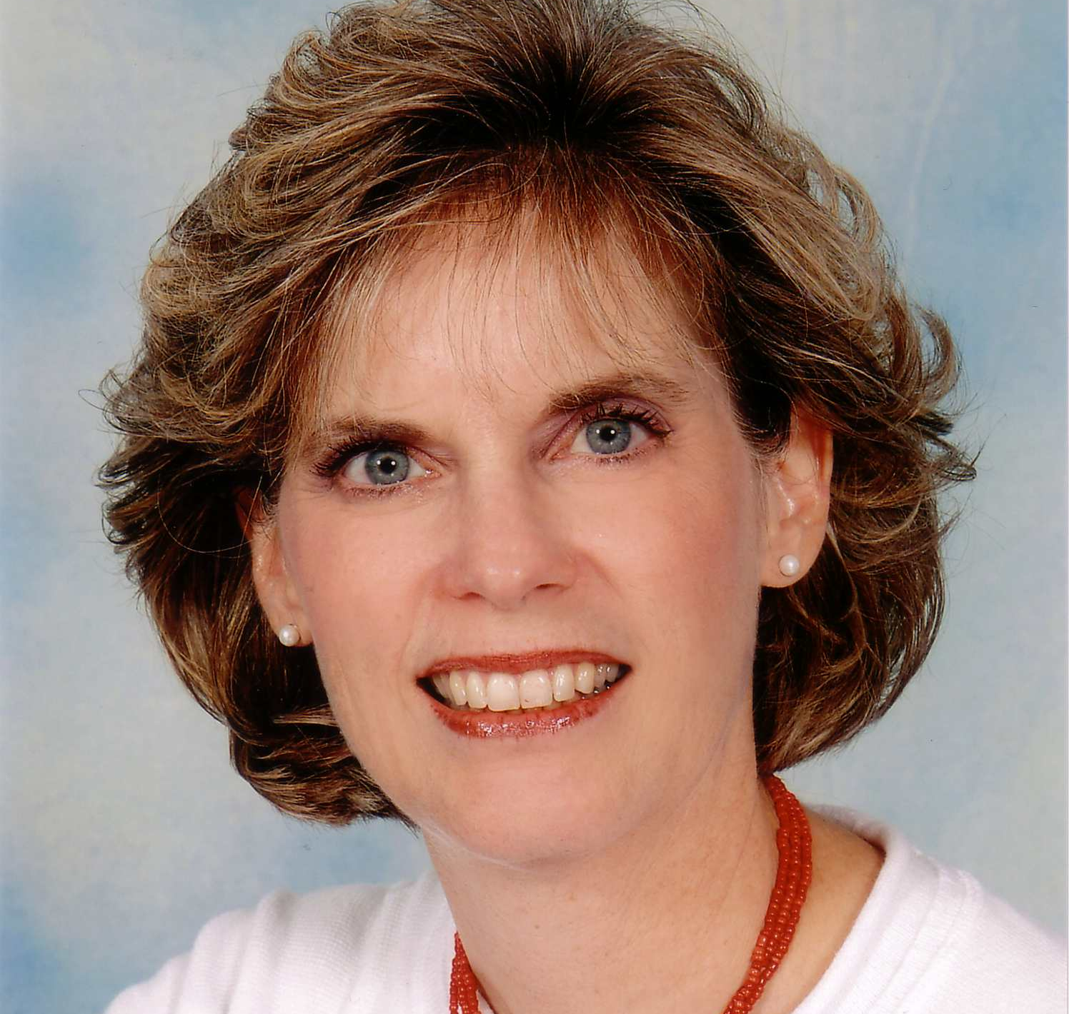
Susan Kay Griffith
Notes:
Yes, Kay is her middle name. Her full name is now Susan Kay Griffith.

Slide 9

Matthew's Relational Pillars
Matthew's Relational Pillars
5:23-24
You are:
Offender
Issue:
General
Notes:
Have you ever had a problem with another believer? (If you say "no," then I wonder which planet you have been living on!) Are you in fellowship with every Christian that you know now—your family members, your work colleagues, your neighbors and friends? If you’re not in harmony, what should you do?
• If you hurt the other person, Matthew 5 tells you what to do in any general issue dividing you.

Slide 10
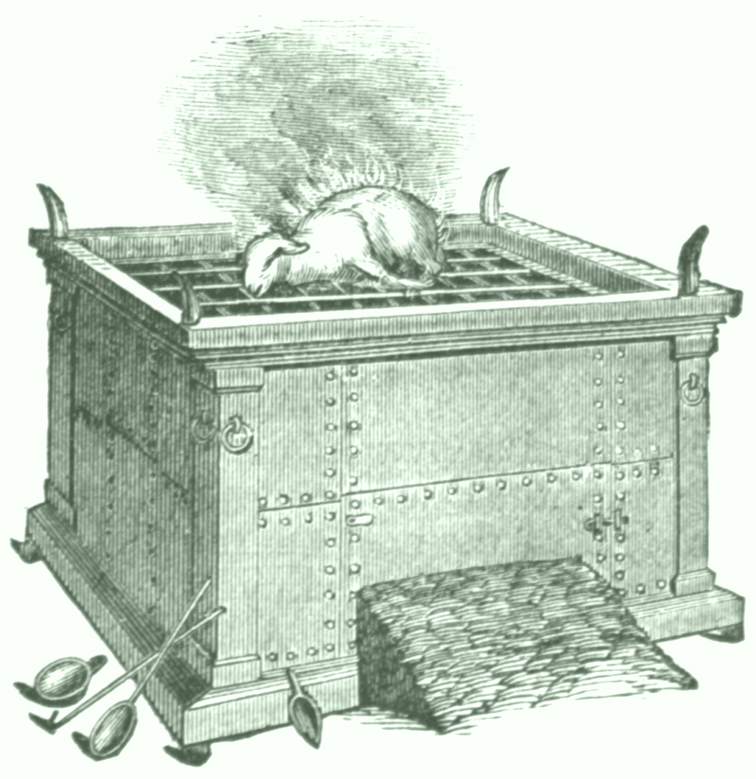

Matthew 5:23-24
Notes:
Let’s read it.
God places the responsibility to reconcile on you if you are the offender.

Slide 11
Matthew 5:23-24
?
"Therefore if you are presenting your offering at the altar, and there remember that your brother has something against you, leave your offering there before the altar and go; first be reconciled to your brother, and then come and present your offering."
Notes:
The last I checked, believers weren’t offering up sacrifices at the altar. So what does the "altar" refer to today?

Slide 12
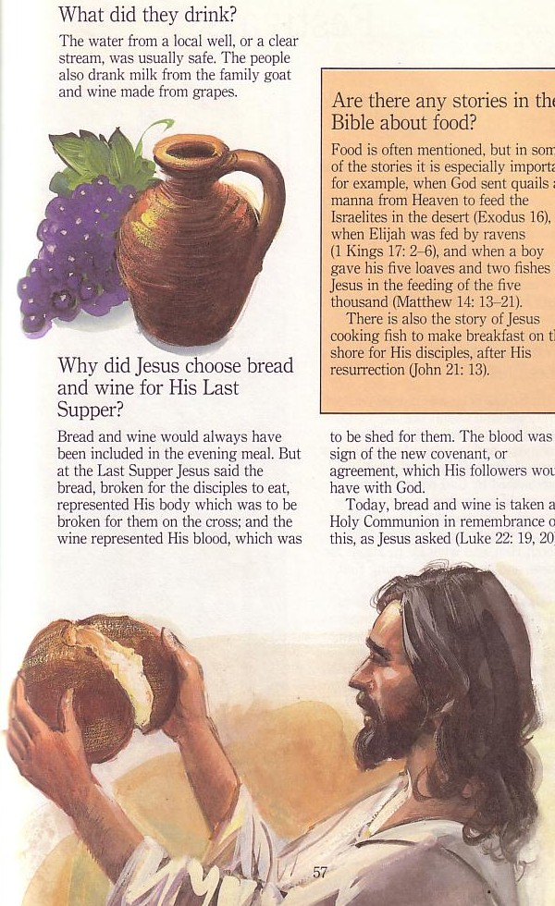
The Lord's Supper
Notes:
At the very least, it refers to the Lord’s table—a sign of our fellowship & unity—so don’t take the Supper when in conflict with another believer.

Slide 13
Matthew's Relational Pillars
Matthew's Relational Pillars
5:23-24
18:15-17
You are:
Offender
Offended
Issue:
General
Sin
Notes:
However, in some situations, you are the offended. The other person is guilty of sin. Every church eventually encounters problems with believers living in sin. In these cases a loving body will restore them to God’s holiness.

Slide 14



How do we restore sinning Christians properly?
Our First Question Today (for vv. 15-17)
Notes:
So how do we restore sinning Christians properly? When someone goes astray from God’s will, what process do we use to bring that person back?

Slide 15




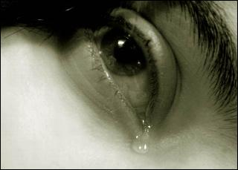
Other Relationships
Notes:
This doesn’t just refer to marriage, nor to serious sins—it's any kind of sin that can hurt any relationship among believers.

Slide 16
Black
Notes:
Why I am talking about resolving relational problems now?
I just know that issues surface in every relationship, including ours. At some point, I am going to offend you and you will offend me. So what should we do?

Slide 17
Matthew 18
The Value of
One
1
1
Child (1-9)
1
Sheep
(10-14)
1
Sinner
(15-20)
1
Debtor
(21-35)
Notes:
So our key text today is Matthew 18. The context of Matthew 18 is the value of one—
• one child (1-9), one sheep (10-14), one sinner (15-20), one debtor (21-35).
• At the heart of this chapter is verses 15-20…

Slide 18
Matthew 18:15-20
If your brother sins against you, go and show him his fault, just between the two of you. If he listens to you, you have won your brother over. ¹⁶But if he will not listen, take one or two others along, so that 'every matter may be established by the testimony of two or three witnesses.' ¹⁷If he refuses to listen to them, tell it to the church; and if he refuses to listen even to the church, treat him as you would a pagan or a tax collector.
¹⁸I tell you the truth, whatever you bind on earth will be bound in heaven, and whatever you loose on earth will be loosed in heaven. ¹⁹Again, I tell you that if two of you on earth agree about anything you ask for, it will be done for you by my Father in heaven. ²⁰For where two or three come together in my name, there am I with them.
How to Restore
15-17
Why to Restore
18-20
Notes:
In Matthew 18:15-20 Jesus provides God’s plan for loving church discipline. Let’s read it together [read 15-20.] This text has two main teachings on restoring Christians in sin.
• Verses 15-17 give how to restore them and…
• Verses 18-20 give why to restore them.
Let’s first see how to restore relationships. God’s way to restore believers in sin is to…

Slide 19

The Point of Verses 15-17
I. Keep the matter as private as possible (15-17).
Notes:
God’s strategy to bring sinning Christians back is to involve as few people as you can.

Slide 20
Our Goal:
Our Goal:
Restoration!
Notes:
The desired end is restoration, not punishment or excommunication.
The goal of discipline is behavior change to bring the wayward one back. Unfortunately, too many churches "excommunicate" to punish rather than restore).
Restoration is God’s goal for a wandering saint in the sheep image of verses 10-14.
Restoration is the explicit teaching of this text in verse 15b.
Restoration is the goal of church discipline in other passages like Galatians 6:1.

Slide 21


Restore People in Sin
Restore People in Sin
"Brothers, if someone is caught in a sin, you who are spiritual should restore him gently."
Galatians 6:1

Slide 22
God's 4-step restoring process…
4
3
2
1
…reveals the issue to more people each step
Notes:
God’s restoring process has four steps that progressively tell more and more people about the sin (15-17).

Slide 23

Step 1 to Restoration
Talk to the person by yourself
M
M
M
M
M
M
M
M
M
M
M
M
M
M
M
M
S
M
M
M
M
M
M
M
M
M
M
M
S = Sinner
M = Member
Notes:
What’s our human tendency here?
• It is to tell others about the problem instead of the one involved.
• God commands us to keep the issue as private as possible.

Slide 24
Matthew's Relational Pillars
Matthew's Relational Pillars
5:23-24
18:15-17
You are:
Offender
Offended
Issue:
General
Sin
Notes:
This differs from Matthew 5 in that you’re not an offender, but the offended.
Note also that in Matthew 5 sin may not be in the picture, but Matthew 18 deals specifically with a believer living in sin. This does not refer simply to differences of opinion on debatable matters.

Slide 25
Matthew's Relational Pillars
Matthew's Relational Pillars
5:23-24
18:15-17
You are:
Offender
Offended
Issue:
General
Sin
Initiative:
You!
You!
Notes:
Earlier we saw from Matthew 5:23-24 that God places the responsibility to reconcile on you if you are the offender. Now whose job is it to initiate if you are the offended?
• Yes, again it is your responsibility again! You say, "That’s not fair! Why is it my job in both situations? Whether I am the offender or the offended I still have to make the first move?" Well, if relationships are not resolved between believers, it has to be through the fault of both—as both have the command of God to resolve it!

Slide 26

Go in Person
Not:
• email
• SMS
• letter
• phone
Notes:
While letter writing was very popular in the time of Christ, our Lord specifically says to deal with these sensitive matters face-to-face. Today this means confrontation should never be handled via email, SMS, letter, or phone calls. It also prohibits the cowardice of anonymous communication.

Slide 27
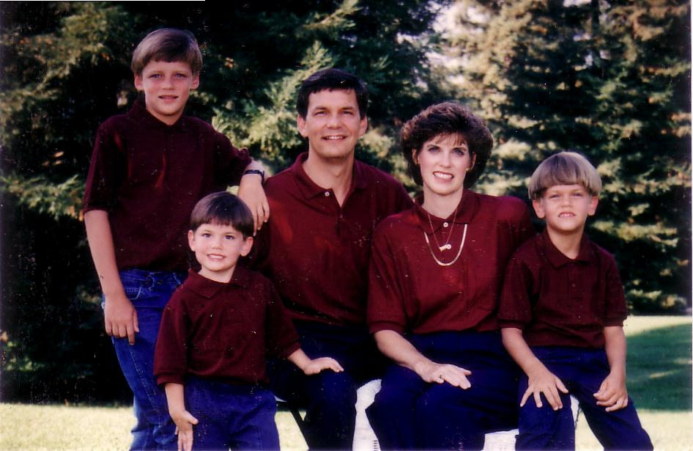
1996
Notes:
Our family has tried to do this since our three sons were young—not to let them do the "Mom! Dad! So-and-so did such-and-such to me!" We just told him, "Matthew 18, bud. If you can’t solve it, we’ll be step 2…" They rarely came back to us!

Slide 28
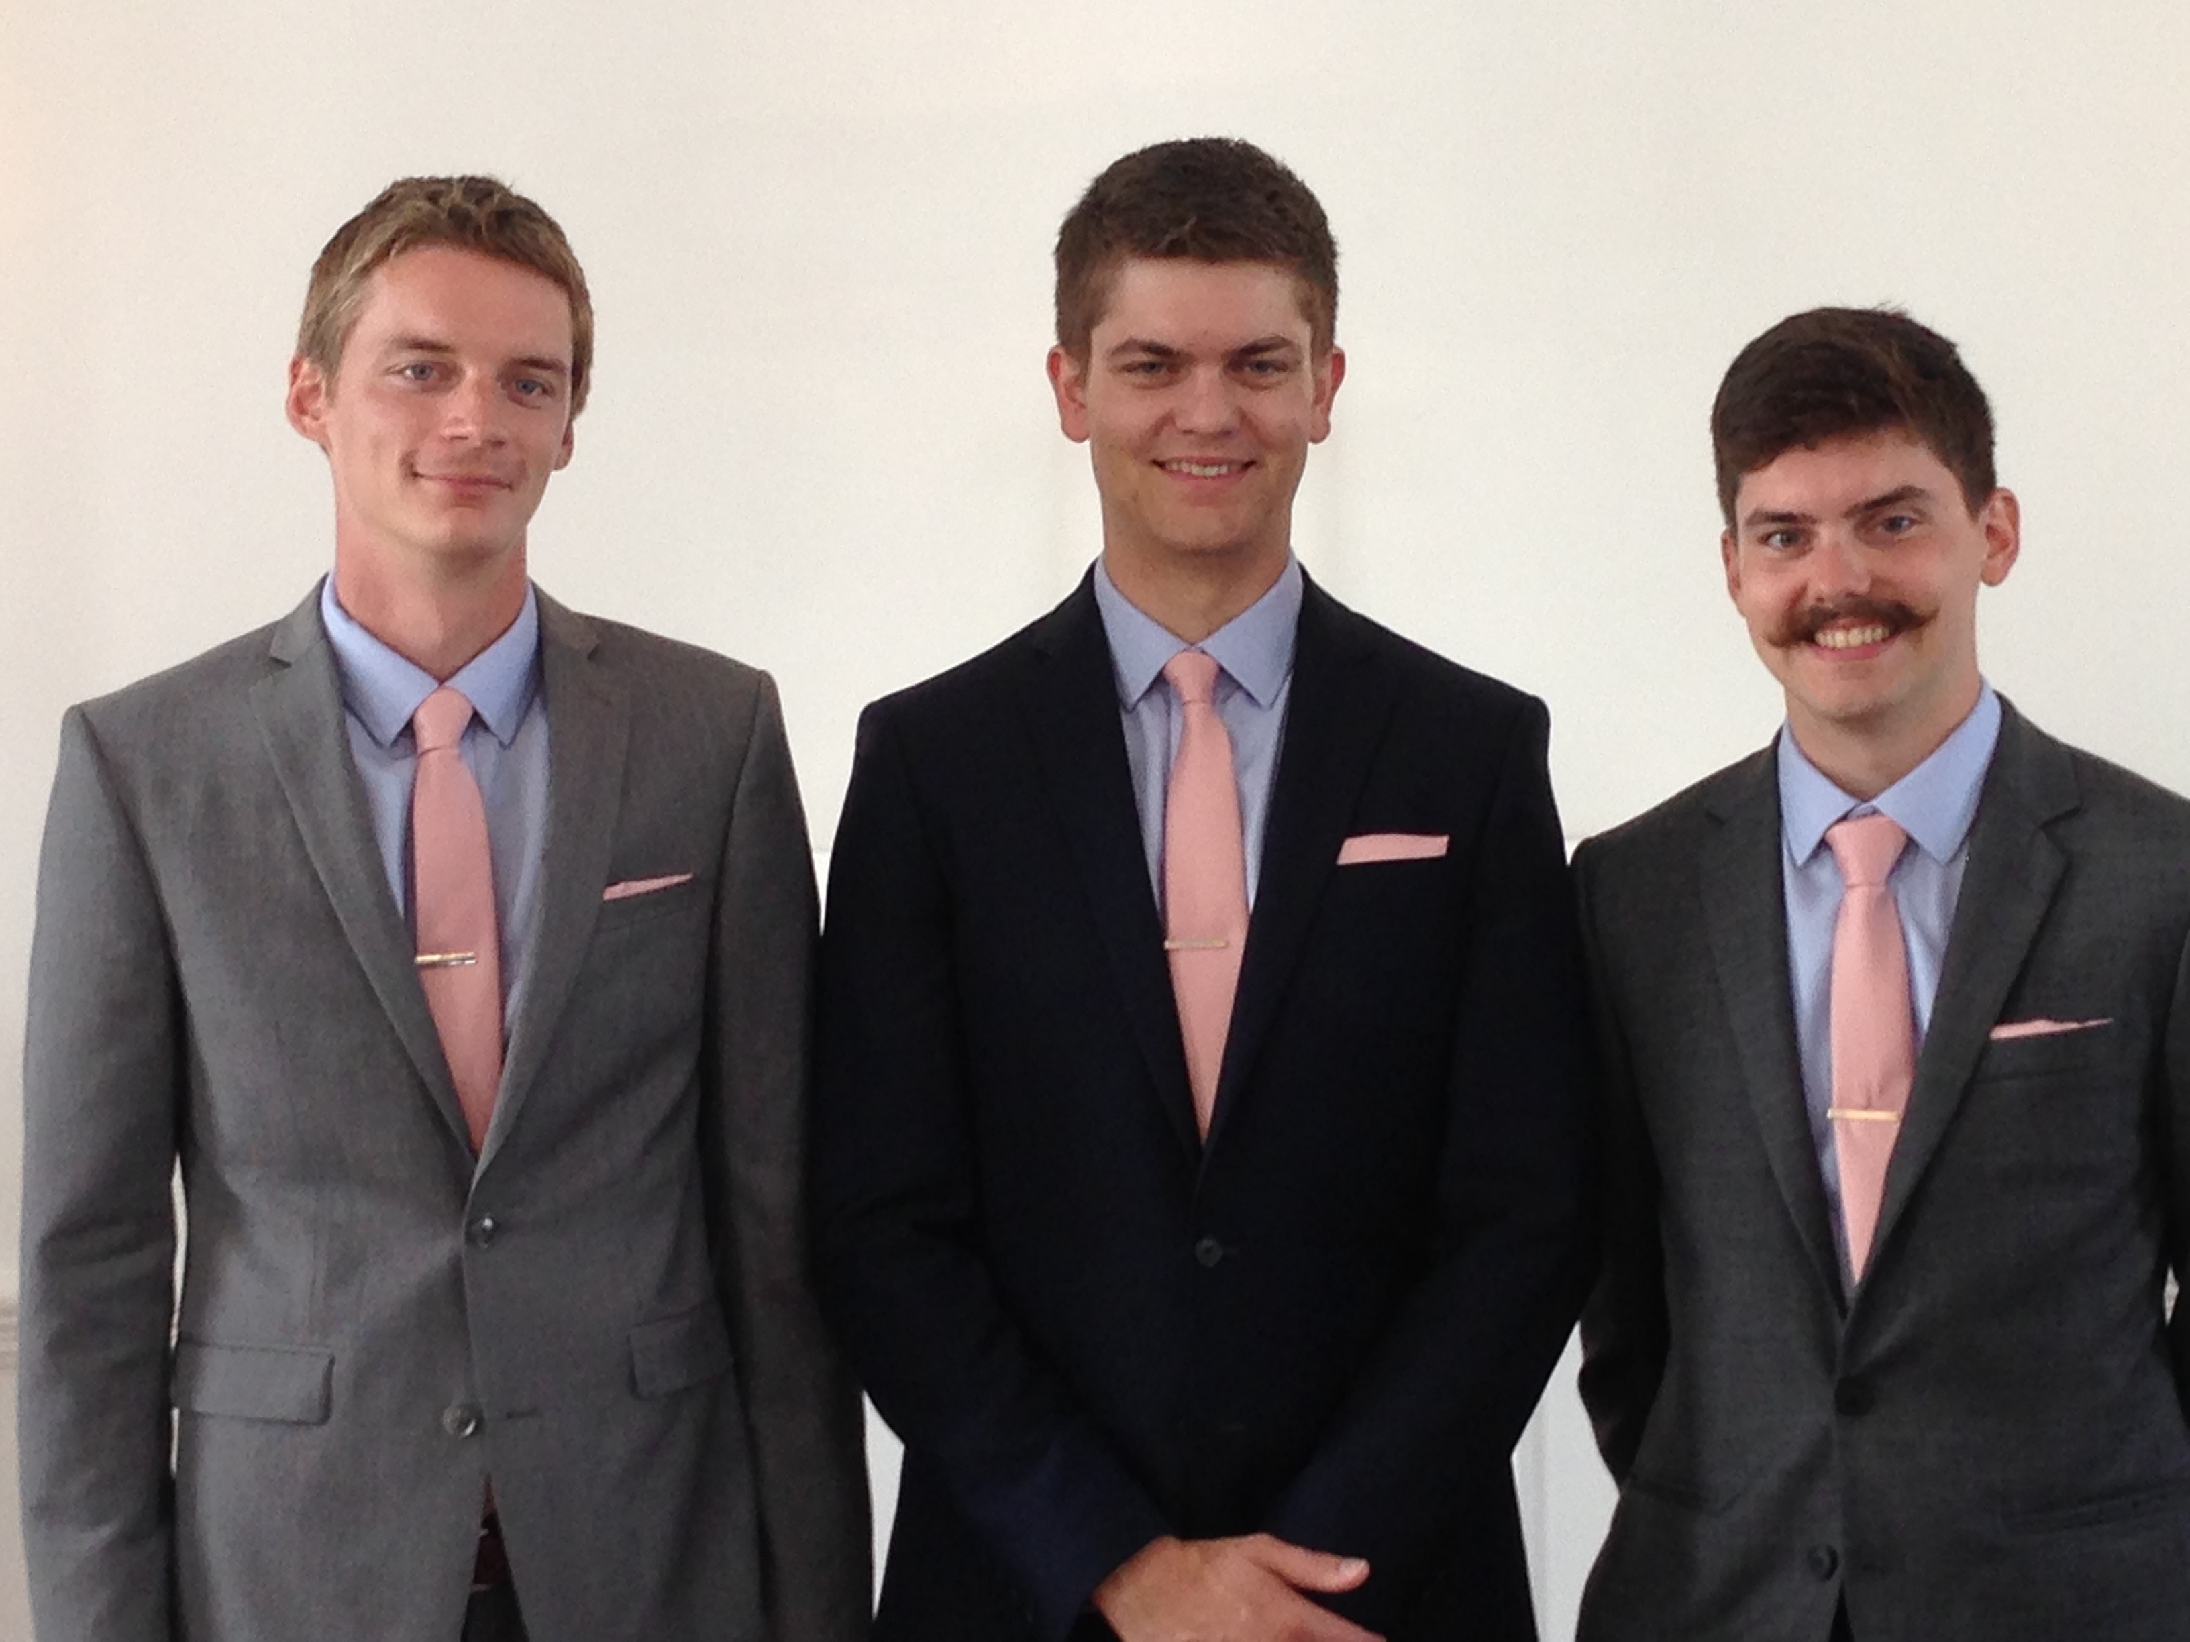
Brothers…
Notes:
Now that they are older, they solve the problems among themselves without our intervention. Some friends were amazed that Kurt and Stephen moved to the US for college and decided to stay as roommates—for 7 years until they married!

Slide 29


Why don't we confront others?
Ignorance
Doubt
Failure
Fear
Excuses
Impurity
Unsocial
Notes:
However, most of the time believers don’t keep issues private—or we don’t address them at all. Why do you think don’t we confront others? Tell the person next to you why! (Small groups for 1 min.) Why not?
• ignorance of what God commands here?
• doubt that it will work?
• failure of past confrontations that didn’t work?
• fear that we might look bad?
• excuses that we can’t get together?
• impurity in our own life?
• unsocial in that we just don’t care enough to risk it?

Slide 30
Step 1 to Restoration
Talk to the person by yourself
M
M
M
M
M
M
M
M
M
M
M
M
M
M
M
M
S
M
M
M
M
M
M
M
M
M
M
M
S = Sinner
M = Member
Notes:
So… you should talk to the person by yourself—even though our tendency is to tell others instead. But what if the offender does not repent? We need step 2 where we…

Slide 31
Step 2 to Restoration
Take 1-2 others along
M
M
M
M
M
M
M
M
M
M
M
M
M
M
M
M
S
M
M
M
M
M
M
M
M
M
M
M
S = Sinner
M = Member
Notes:
Take one or two others along (16).

Slide 32

Questions on Step 2
Who should these people be?
Why take 1-2 others?
Notes:
Who should these 1-2 others be? These persons should be individuals whom the offender respects as they will best help restore him/her. They should not go instead of the offended believer, but along with this person.
• Why take 1-2 others along?

Slide 33
Deut. 19:15
"One witness is not enough to convict a man accused of any crime or offense he may have committed. A matter must be established by the testimony of two or three witnesses."
Notes:
The OT law prohibited conviction of crimes based on only one person’s testimony (read Deut. 19:15). The NT teaching is the same, protecting the offender from an easily offended or lying accuser.
What if the offender still does not repent? Go to step 3…

Slide 34
Step 3 to Restoration
Expose the sin to the entire church
M
M
M
M
M
M
M
M
M
M
M
M
M
M
M
M
S
M
M
M
M
M
M
M
M
M
M
M
S = Sinner
M = Member
Notes:
The church leadership certainly must be involved at this point before the matter is brought to the congregation. They also must see the issue isn’t just a difference of opinion between two parties; the biblical basis for the offender living in sin must be clearly shown with specific passages.

Slide 35
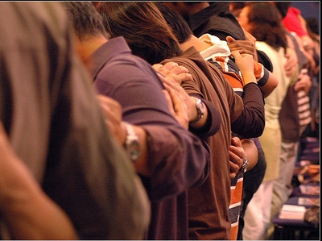
Why tell the whole church?
Notes:
Bringing the matter to the entire church is vital, since without it the sinning person will be able to find fellowship in other smaller groups within the larger church who do not know of his/her sin. Such gossip situations inevitably bring disunity, which lead to factions that can split the body.
What, then, should the entire church do once discipline has been determined? Step 4…

Slide 36
Step 4 to Restoration
Treat the person as an unbeliever
M
M
M
M
M
M
M
M
M
M
M
M
M
M
M
M
S
M
M
M
M
M
M
M
M
M
M
M
S = Sinner
M = Member
S

Slide 37

Sins Worthy of Discipline
How NOT to Discipline
EXCOMMUNICATE !
Notes:
Sometimes this step has been misinterpreted to mean "excommunication" where the errant person is never contacted again.

Slide 38

Sins Worthy of Discipline
How to Discipline Him/Her
Don't refer to him/her as a Christian.
Evangelize this person.
Don't let him/her take the Lord's Supper.
Remove the person from membership.
Remove this person from church roles.
Unbeliever
"Deliver over to Satan" one in sex sin
(1 Cor. 5:5).
Don't eat with him/her (1 Cor. 5:11).
Prohibit him/her from attending church?
Worse
Notes:
But Jesus said to "treat him as you would a pagan or a tax collector." Jesus treated pagans with love and kindness, but he didn’t ask them to evangelize the lost as part of his team. You shouldn’t be ugly or ungodly, but…
• Don’t refer to him/her as a Christian. (ILL: I have done this with my former brother-in-law who divorced my sister to marry another woman.)
• Evangelize this person.
• Don’t let him/her take the Lord’s Supper.
• Remove the person from membership.
• Remove this person from church roles (ILL: My friend Paula was asked to leave her church kitchen ministry once her adultery was discovered.)
But in other ways it is more serious than how we treat unbelievers:
• "Deliver over to Satan" one in sex sin (1 Cor. 5:5). Years ago a friend named John left his wife and two small boys for another woman. My church disciplined him, but an elder kept up with him to restore him. After five years, he showed up at church—but he looked 20 years older!
• Don’t eat with him/her (1 Cor. 5:11).
• Should we prohibit the person from attending church? Some say they, like unbelievers, should be welcomed in services without taking the Lord’s Supper; but in most discipline cases this is not even an issue as few disciplined believers seek to return to the assembly until repentant.

Slide 39
The Point of Verses 15-17
I. Keep the matter as private as possible (15-17).
Notes:
So that’s God’s 4-step process—to keep the matter as private as possible.

Slide 40
God's 4-step restoring process…
4
3
2
1
…reveals the issue to more people each step
Notes:
This is the intent in each of the four steps with the goal of restoration.

Slide 41

Our 2nd question is answered in verses 18-20:
Why do we restore sinning Christians properly?
Notes:
But why must we do all this? What right do we have to discipline our members? Why must we restore sinning Christians properly? Because…

Slide 42

The Point of Verses 18-20
II. Our church extends the authority of God Himself!
Notes:
God’s right to judge is actually delegated to us!

Slide 43

Why discipline?
When we seek to restore someone…
We act in the place
of the Father
(18-19)
Notes:
We act in the place of the Father when we seek to restore someone (18-19).

Slide 44
A Better Translation…
NAU is a Better Translation…
NIV "I tell you the truth, whatever you bind on earth
will be {or have been} bound in heaven, and whatever you loose on earth will be {or have been} loosed in heaven."
NAU "Truly I say to you, whatever you bind on earth shall have been bound in heaven; and whatever you loose on earth shall have been loosed in heaven."
Notes:
Too often today’s churches act as if they have no authority under God, and yet "binding" here refers to disciplining (a guilty verdict) while "loosing" refers to releasing from discipline (an innocent verdict).

Slide 45

Matthew 18:19
"Again, I tell you that if two of you on earth agree about anything you ask for, it will be done for you by my Father in heaven"
(NIV).
Notes:
We should trust that our prayerful judgments are God’s will.

Slide 46
Psalm 82:1, 6
(to Israel's rulers/gods)
"I said, 'You are "gods"; you are all sons of the Most High… but you will die like men…"
Notes:
Ps. 82:6 has a similar idea where Israel’s rulers are called "gods" in that they rule others.
Why should we trust this process in discipline situations? Verse 20 says that…

Slide 47
Why discipline?
When we seek to restore someone…
We act in the place
of the Father
(18-19)
We act in the presence & authority of Christ
(20)
Notes:
When we seek to restore someone, we act in the presence and authority of Christ (20).

Slide 48
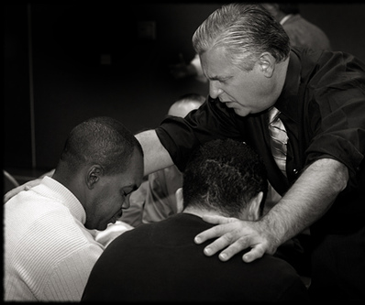
Matthew 18:20
"For where
two or three come together in my name, there I am with them" (NIV).
Notes:
The "two or three" refers to the witnesses whose testimony enacted discipline (v. 16).
The point of Christ being "in their midst" is that local church discipline acts with the presence and authority of Christ Himself.

Slide 49
Why do we restore sinning Christians properly?
Notes:
So how can we sum up this passage in one sentence? I’d say it this way…

Slide 50

Main Idea:
We must restore sinning members properly since we act on God's behalf
Notes:
When sheep stray, we shepherd them back as loving hands of God’s grace.

Slide 51
Matthew's Relational Pillars
Matthew's Relational Pillars
5:23-24
18:15-17
You are:
Offender
Offended
Issue:
General
Sin
Initiative:
You!
You!
Notes:
God expects each of us to take the initiative—

Slide 52

The Overall Principle
"If possible, as far as it depends on you, be at peace with all men"
Romans 12:18
Notes:
—and to do so as far as possible, as Romans 12:18 says [read]. This verse is a great encouragement to do all we can even if others are not responsive.

Slide 53
Matthew's Relational Pillars
Matthew's Relational Pillars
5:23-24
18:15-17
The Overall Principle: Romans 12:18
You are:
Offender
Offended
Issue:
General
Sin
Initiative:
You!
You!
Notes:
This verse is a great overall principle in relationships.

Slide 54

Make us one 3/3
Make us one, Lord,
make us one,
Holy Spirit, make us one.
Let Your love flow
so the world will know
we are one in You.
Notes:
God desires us to truly live out the chorus "Make Us One, Lord"

Slide 55
What's God Saying to You?
a. The Church Body
M
M
M
M
M
M
M
M
M
M
M
M
b. Your Own Life
M
M
M
M
S
M
M
M
M
M
M
M
M
c. Helping Others
M
M
M
Notes:
Matthew 18 relates to us in at least three ways:
• To be in this assembly you must submit to its authority under God. This means that we will lovingly seek to restore you should you fall.
• Is there sin in you worthy of discipline? Clean it up now to avoid pain for us all!
• Do you know anyone who needs a private confrontation? Romans 12:18 encourages you to do everything possible to be at peace with all people, so do it!

Slide 56


NT Preaching link at BibleStudyDownloads.org
Get this presentation and script for free!
Notes:
If you want this message PPT and text, just download it at BibleStudyDownloads.org at the NT Preaching link.

Slide 57
Black

